Slide 1
Vendor Briefing – Marketing Mix Modeling
Selecting the Right Partner for Our Marketing Analysis

Slide 2
What We’ll Cover
Marketing Mix Modeling Objectives
Timeline
Vendor Selection Criteria
Q&A

Slide 3
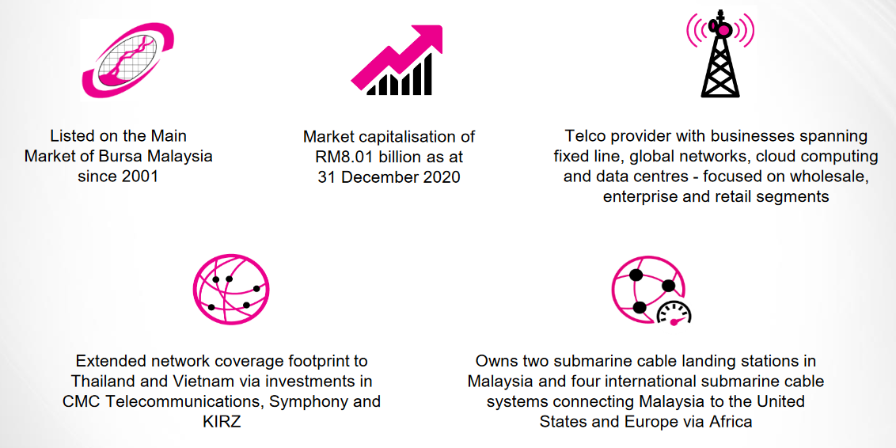
Who we are
MMM

Slide 4
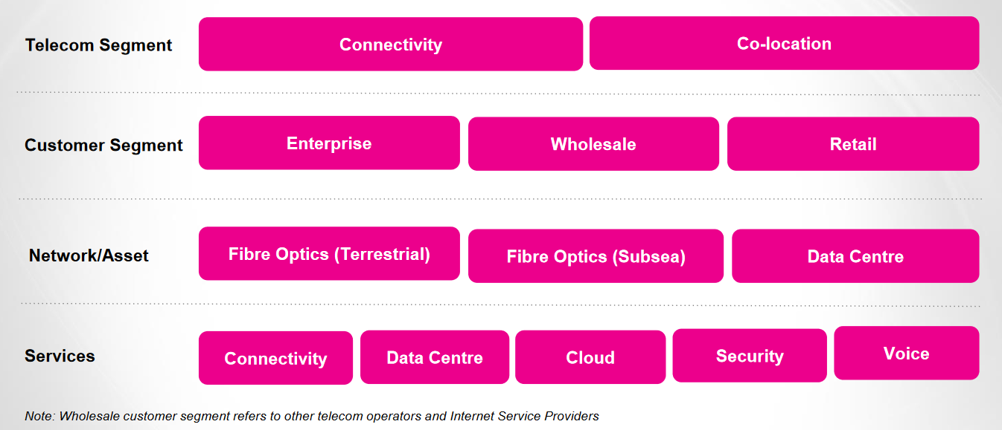
Who we are
MMM

Slide 5
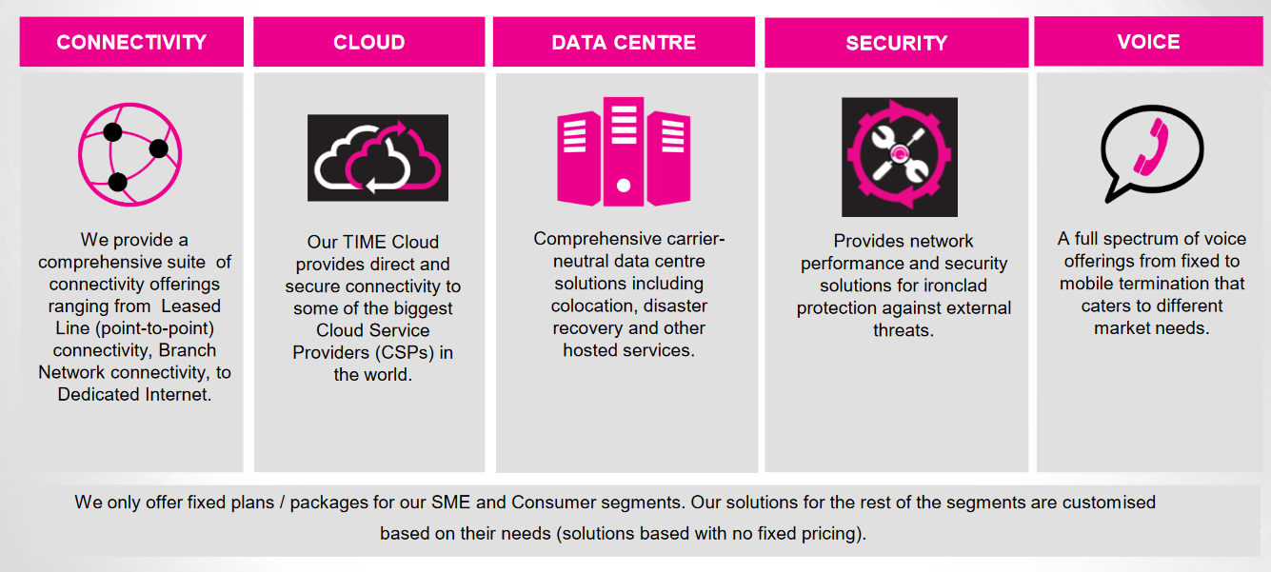
Our product
MMM

Slide 6
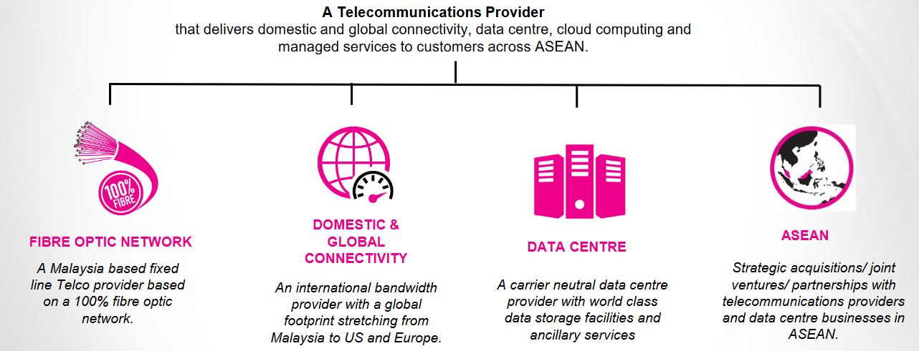
Our business pillar
MMM

Slide 7
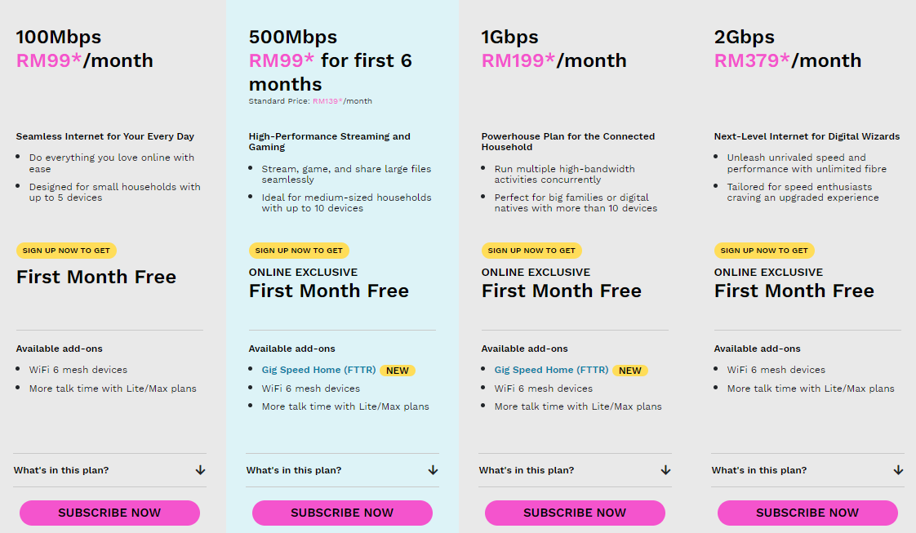
Our product offering
MMM
All promotions displayed are applicable to 24-month contract plans and available for a limited time only. Terms and conditions apply.
No contract subscribers are subject to a one-time charge: RM400 for the 100Mbps plan, RM650 for the 500Mbps plan and RM800 for the 1Gbps plan.
Read our Terms and Conditions in full here.
*Price(s) displayed are subject to 6% Service Tax where applicable.

Slide 8
The Brief

Slide 9
Objectives
MMM
Business Objectives:
Increasing sales and market share
Marketing strategy:
Fully optimize marketing channels to create leads and drive sign ups
Marketing objectives for the next 3 years:
1. Run Effective Marketing Campaigns
2. Optimal Allocation of Marketing Budget
3. Scenario Planning, Forecasting and Testing

Slide 10
Task 1
Marketing Mix Assessment and Optimization Proposal
MMM
Objective:
Showcase the model MMM dashboard to demonstrate the following but not limited to:
Activities:
Descriptive model analysis (key drivers and analysis
Prescriptive actions
Predictive results and impact
Budget allocation and recommendations
Ongoing optimization

Slide 11
Customer Interaction Model Definition
Task 2
MMM
Objective:
Establish a streamlined model for customer interaction throughout the Marketing Mix Modeling (MMM) process, defining touchpoints, frequency, and cadence.
Activities:
Identify key interaction touchpoints in the MMM journey.
Determine the frequency and cadence of customer engagements at each stage.
Define the nature of interactions to ensure effective collaboration.
Assess the pros and cons of managed service and self-service approaches.
Develop a comprehensive plan for implementing the chosen service model.
Communicate changes to stakeholders and initiate the transition process.
Identify key roles and responsibilities in the MMM process.
Assess whether resources will be internally managed or externally sourced.
Determine the optimal placement of resources to provide effective coverage.

Slide 12
Criteria

Slide 13
Criteria – Our KPi
MMM
The MMM needs to be able to answer these questions
What percentage of total sales is driven by each marketing channel?
How does the sales contribution from each channel compare to its share of investment?
How do non-media factors contribute to sales?
What percentage of sales would be lost if all media investments were cancelled?
Does digital media drive offline sales?
What is the historic ROI for each media channel?
What is the marginal ROI for each media channel?
What is the recommended budget allocation for each channel
Which tactics (creative, targeting, ad formats) contribute most to my media profitability?
What are the direct and indirect effects of media channels?
How does my media drive both short and long-term sales?
How do media channels compare in their ability to drive sales and brand outcomes?
How do I balance my media mix to drive both short and long-term sales?
What are the synergies between media channels?
The following KPIs are (planned to be) included in our MMM?
Online sales
Offline sales
Total sales
Online action (leads, subscriptions,
contracts, orders, etc.)
Offline actions
Total actions
Visit to site
Share of Search
Google query volume
Purchase intent
Brand consideration
Brand preference/liking
Brand awareness

Slide 14
Criteria – Vendor
MMM
What we expect from you
Marginal ROIs (return on the next $1 invested).
Response curves
Hypotheses as to which factors influenced media ROIs.
Budget optimisation scenarios.
Recommended actions outside of the media budgets.
ROIs by channel.
ROIs by ad format.
ROIs by creative.
ROIs by targeting.
ROI by bidding strategy or buy model, e.g. CPM, CPV, CPA (if applicable).
Clear and informative charts and data visualisations.
Explanation of the model results and consultation

Slide 15
Timeline

Slide 16
Timeline
MMM
Briefing 5th Dec
Pitch development 6th – 13th Dec
Submission
13th Dec 5PM
Presentation 13th – 14th Dec
Award
End Dec 23’ – Early Jan 24’
Dec
Jan

Slide 17
Judging Criteria
MMM
Expertise and Track Record
Methodology and approach
Technology and Analytical Capabilities
Customization and Collaboration
30%
30%
25%
15%
Technical proposal weightage – 70%
Commercial proposal weightage – 30%

